Slide 1


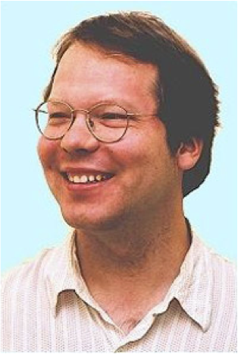



What is the value of an action in ice hockey?
Kurt Routley
Oliver Schulte
Zeyu Zhao
Tim Schwartz
Sajjad Gholami
Notes:
also SportLoqig and Mohammed

Slide 2
AI Meets Sports Analytics Meets Big Data
North American Sports: $485 Billion
Sports Analytics:
growing in industry.
$72.5M Investment in Hudl.
growing in academia.
#Sports Analytics papers 2008-2015 = 7x #applied operations research papers.
AI
modelling and learning game strategies.
multi-agent systems.
structured data.
Notes:
https://www.plunkettresearch.com/industries/sports-recreation-leisure-market-research/
hudl.com

Slide 3

The Big Picture
Sports
Analytics
Reinforcement Learning
on-line intro text
by Sutton and Barto
Notes:
*Nice application for RL
*Revolutionary for sports analytics

Slide 4

Performance Evaluation

Slide 5
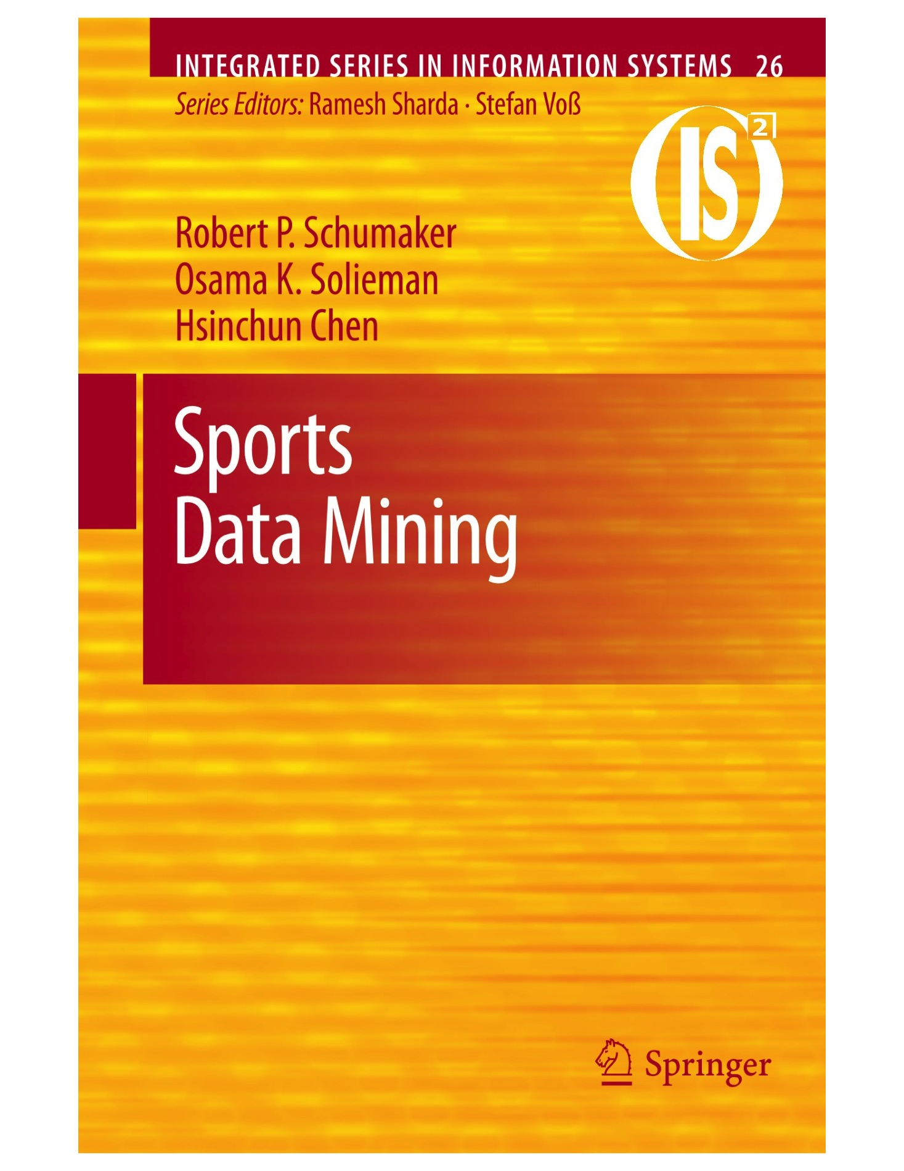
Two Main Problems in Sports Analytics
Sports Analytics
Evaluate Player/Team Performance
Predict Match Outcomes
Identify strengths, weaknesses
Advise on drafts, trades
Notes:
https://dtai.cs.kuleuven.be/events/MLSA15/index.php
Add money ball picture
Italics is for topic today.

Slide 6
Performance Evaluation Approaches
Evaluate Player/Team Performance
Latent Strength Model Chess: Elo Rating
Gaming: MS TrueSkill
Action Value Counts
Issues
entails transitivity
interpretable?
considers final results only
Notes:
https://dtai.cs.kuleuven.be/events/MLSA15/index.php
Add money ball picture
Italics is for topic today.

Slide 7
What is the value of an action?
Olympics 2010 Golden Goal
Issues for action values:
Common scale for all actions
Context-awareness
Lookahead
Notes:
go to about 3 min into
Discuss issues:
context matters: not all goals are equal. Need to know score, overtime.
what about negative points for defenders?
What about Igla assisting? How much is an assist worth vs. a goal?
What about other players on the ice further behind?
What about medium-term events – passes, penalties?
The problem is that we have a continuous flow nonepisodic game

Slide 8
Action Values: Current Approaches
Sabermetrics in Baseball
+/- Score in ice hockey
nhl.com
Advanced Stats
Notes:
sabermetrics: note how many there are!
Action examples. E.g. face-off win -> shot on target.
http://www.nhl.com/stats/player?reportType=season&report=skatersummary&season=20152016&gameType=2&sort=points&aggregate=0&pos=S
http://thehockeymovement.com/advanced-stats-for-beer-league-hockey/

Slide 9
AI and Lookahead
Search

Slide 10
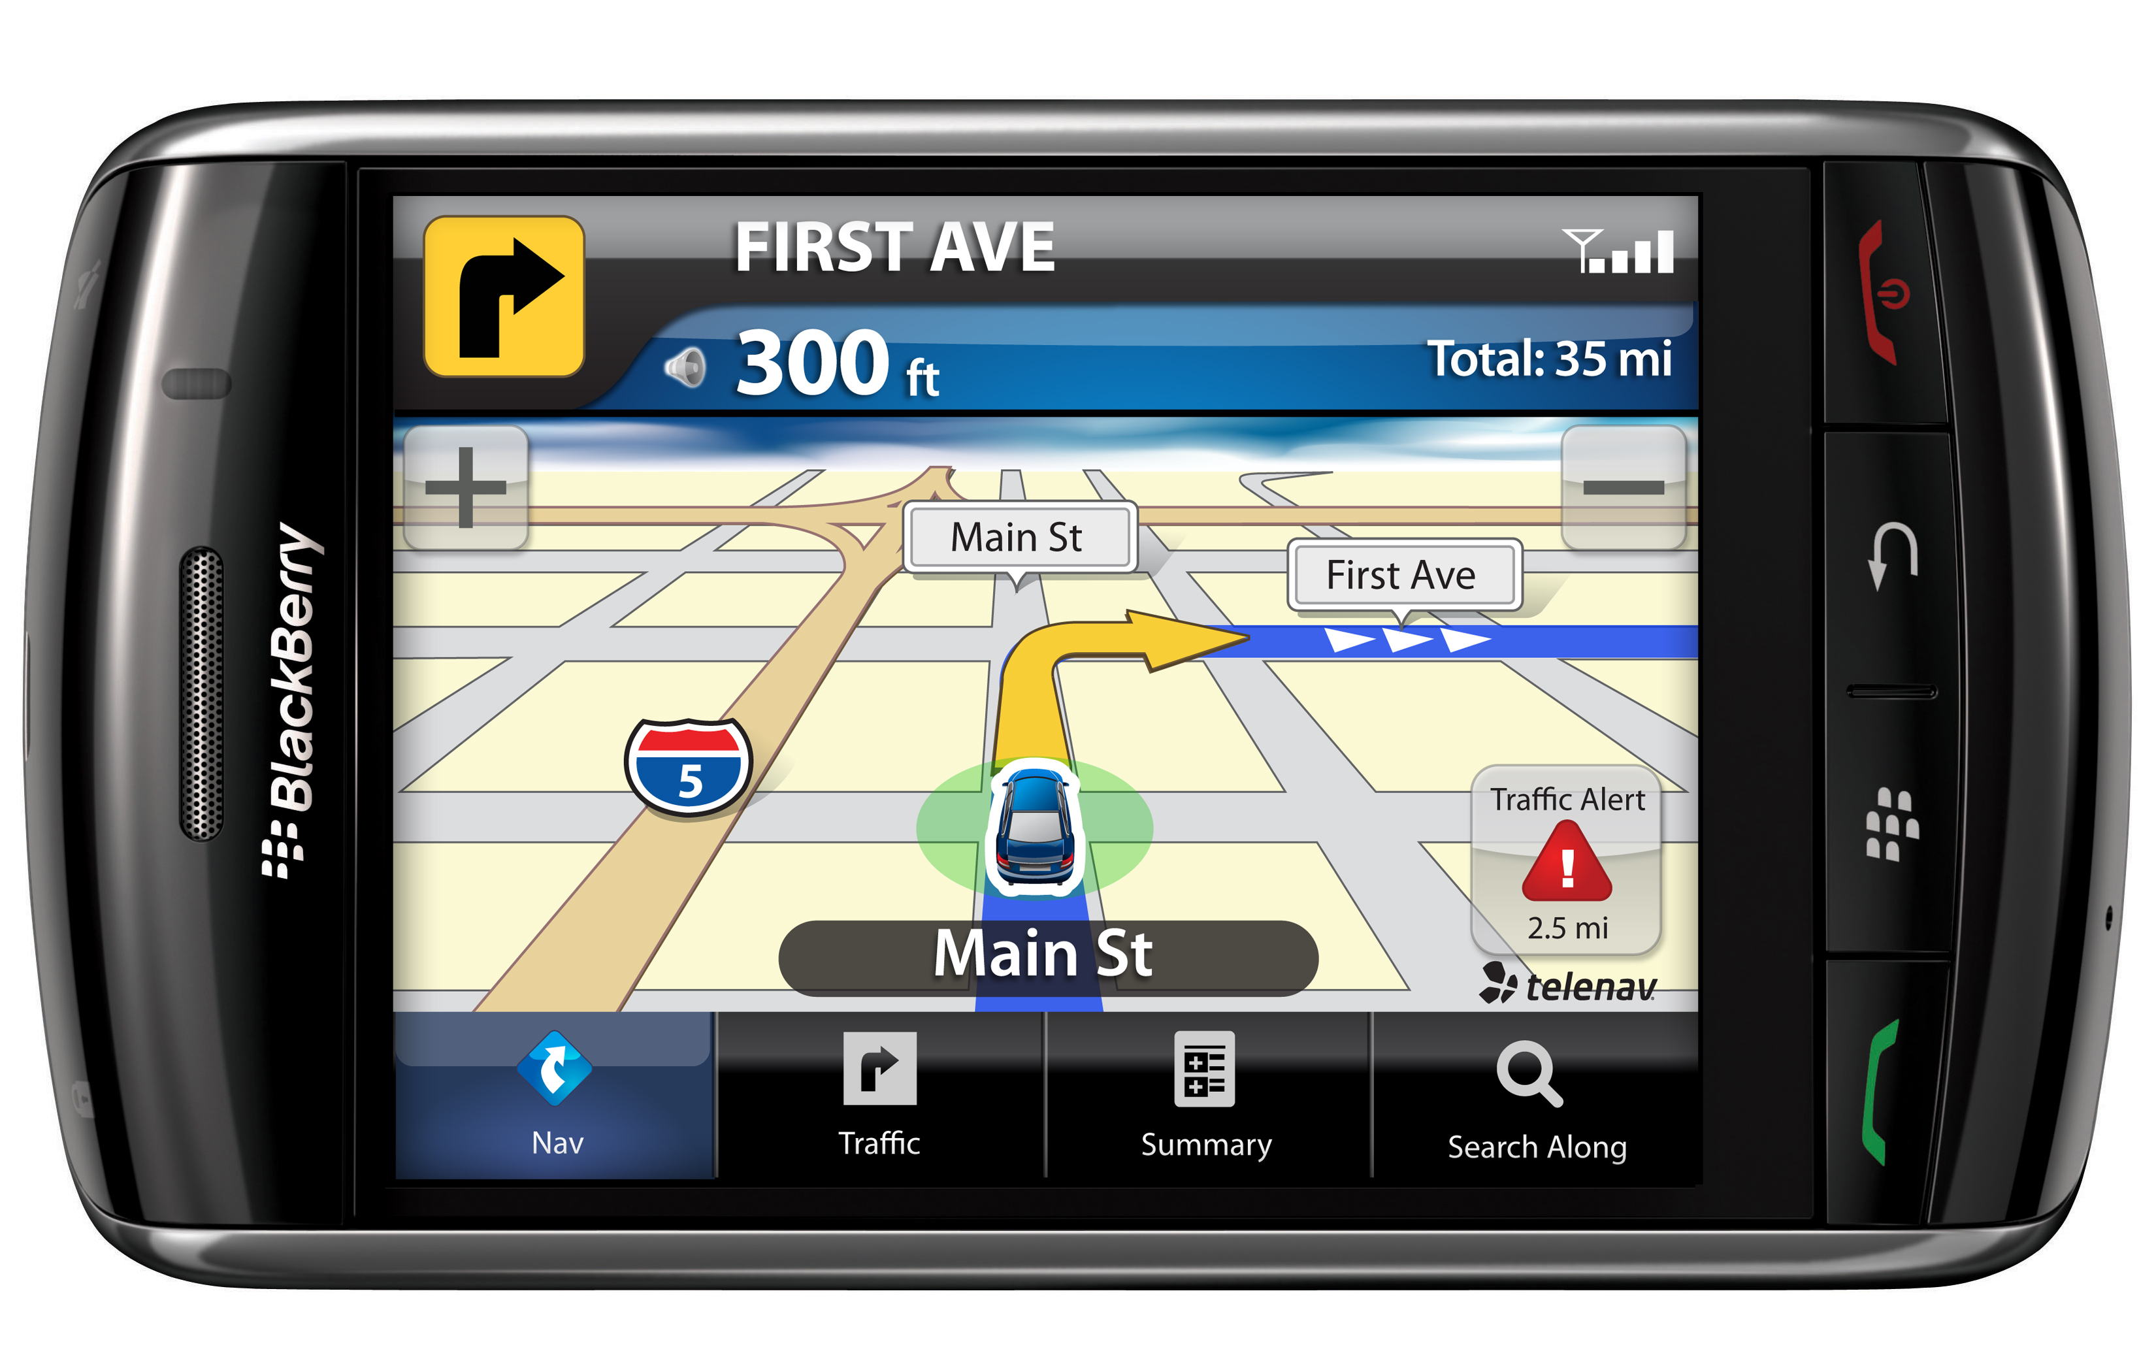
Lookahead
Many areas of AI and optimization involve lookahead.
In AI this is called search.
Example: GPS route planning.

Slide 11
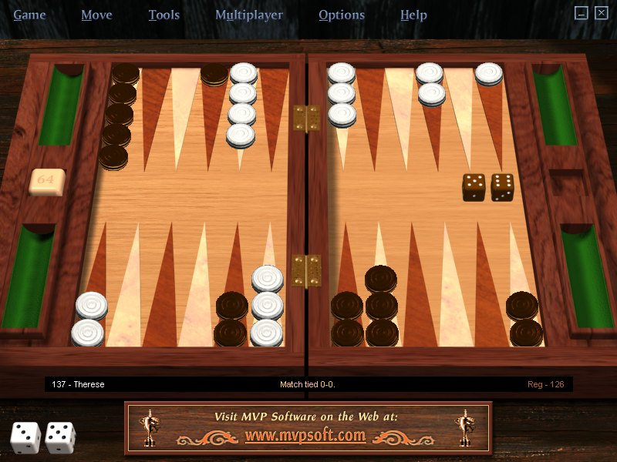
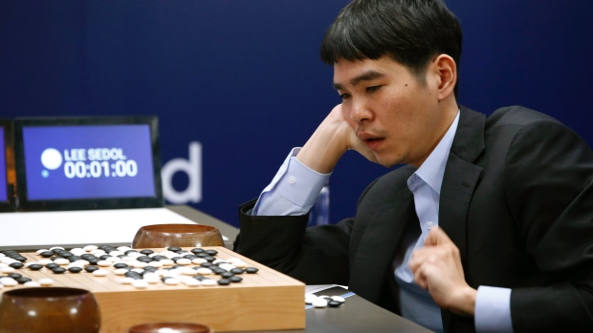
Game Search Examples
Backgammon
AlphaGo!
Chess. http://mygames.chessbase.com/js/apps/MyGames/

Slide 12
State Space View
Markov Chain Demo
our nhl model > 1M nodes
Solving a Markov Decision Process
Value Iteration Demo
Notes:
chain demo has no actions, rewards
value iteration demo can also illustrate impact

Slide 13
Action Impact
Expected reward after action
Expected reward before action
How much does the action change the expected reward at the current state?
Example: how much does the action change the chance of winning at the current state?

Slide 14
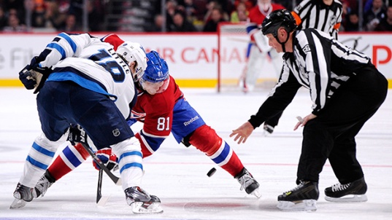
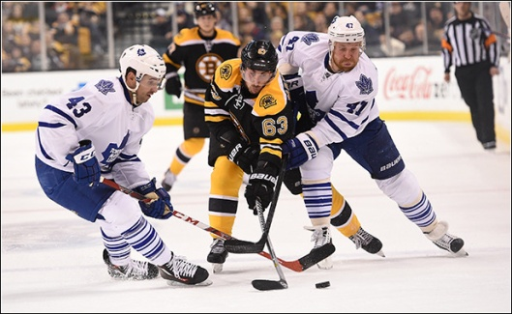
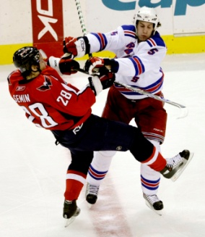
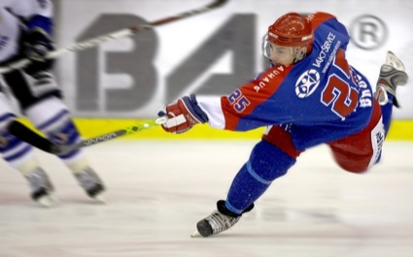
A Markov Game Model for the NHL

Slide 15
Markov Game Model
Transition graph with 5 parts:
Players/Agents P
States S
Actions A
Transition Probabilities T
Rewards R
Transitions, Rewards depend on state and tuple of actions, one for each agent.
Notes:
We use a variant of AD-Trees as a data structure for the Markov Game model
States correspond to nodes
Actions correspond to edges

Slide 16
Example Trajectory (I)
GD = Goal Differential MP = ManPower PR = Period CV = chance that home team scores next goal
Notes:
Q-value ticker

Slide 17
Example Trajectory on Rink (I)
Notes:
Q-value ticker

Slide 18
Example Trajectory (II)
GD = Goal Differential MP = ManPower PR = Period CV = chance that home team scores next goal
Notes:
Q-value ticker

Slide 19
Example Trajectory on Rink (II)
Notes:
Q-value ticker

Slide 20
Example Trajectory (III)
GD = Goal Differential MP = ManPower PR = Period CV = chance that home team scores next goal
Notes:
Q-value ticker

Slide 21
Example Trajectory on Rink (III)
Notes:
Q-value ticker

Slide 22
Example Trajectory (IV)
Notes:
Q-value ticker

Slide 23
Example Trajectory on Rink (IV)
Notes:
Q-value ticker

Slide 24
Example Trajectory (V)
Notes:
fix arrows

Slide 25
Example Trajectory on Rink (V)
Notes:
Q-value ticker

Slide 26
Example Trajectory (VI)
Notes:
Q-value ticker

Slide 27
Example Trajectory on Rink (VI)
Notes:
Q-value ticker

Slide 28
Whole Trajectory on Rink
Notes:
Q-value ticker

Slide 29
Team-Level Modelling
Players in our Markov game = {Home, Away}.
Models average or random player.
Notes:
Normal in ice hockey. But not cricket or baseball. Nor in basketball.

Slide 30
Markov Game Model: State Space
Context Features
Goal Differential GD
Manpower Differential MD
Period PR

Slide 31
Markov Game Model: Actions
Action Types
Blocked Shot
Faceoff
Giveaway
Goal
Hit
Missed Shot
Shot
Takeaway
...
13 Action Types
Action parameters: team, location.
faceoff(Home,Neutral)
shot(Home,Offensive)
hit(Away,Defensive
Notes:
From NHL.com

Slide 32
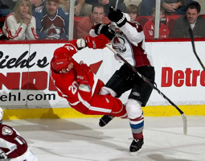
Markov Game Model: Actions
Use action description notation (Levesque et al, 1998)
Actions written in form a(T,L)
Action a
Team T
Location/Zone L
faceoff(Home,Neutral)
shot(Home,Offensive)
hit(Away,Defensive)

Slide 33
Markov Game Model: Transitions
Transition probabilities are estimated from observances in play-by-play data
Record occurrences of state s as Occ(s)
Record occurrences of transition as Occ(s,s’)
Parameter Learning.
Transition probabilities T estimated as Occ(s,s’) / Occ(s).

Slide 34
Markov Game Models: Rewards
Goals
R(s) = 1 if s corresponds to a goal(Home,*)
R(s) = -1 if s corresponds to a goal(Away,*)
R(s) = 0 otherwise
Penalties
R(s) = 1 if s corresponds to a penalty(Home,*)
R(s) = -1 if s corresponds to a penalty(Away,*)
R(s) = 0 otherwise
Wins
R(s) = 1 if s corresponds to a Win(Home)
R(s) = -1 if s corresponds to a Win(Away)
R(s) = 0 otherwise

Slide 35
Local Transition Examples
Basketball Demo - Open in Chrome
Notes:
Away: MD Not 2 = Penalty Ends.
http://projects.yisongyue.com/bballpredict/

Slide 36
Value Learning for Ice Hockey
The Data
Notes:
value learning = V and Q learning

Slide 37
Sports Data Types
Complete Tracking: which player is where when. Plus the ball/puck. ★
Box Score: Action Counts.
Play-By-Play: Action/Event Sequence.
Notes:
Action vs. Event: not clearly distinguished.

Slide 38

Tracking Data
Basketball Example from SportsVU
Coming to the NHL?

Slide 39

Box Score
Oilers vs. Canucks

Slide 40
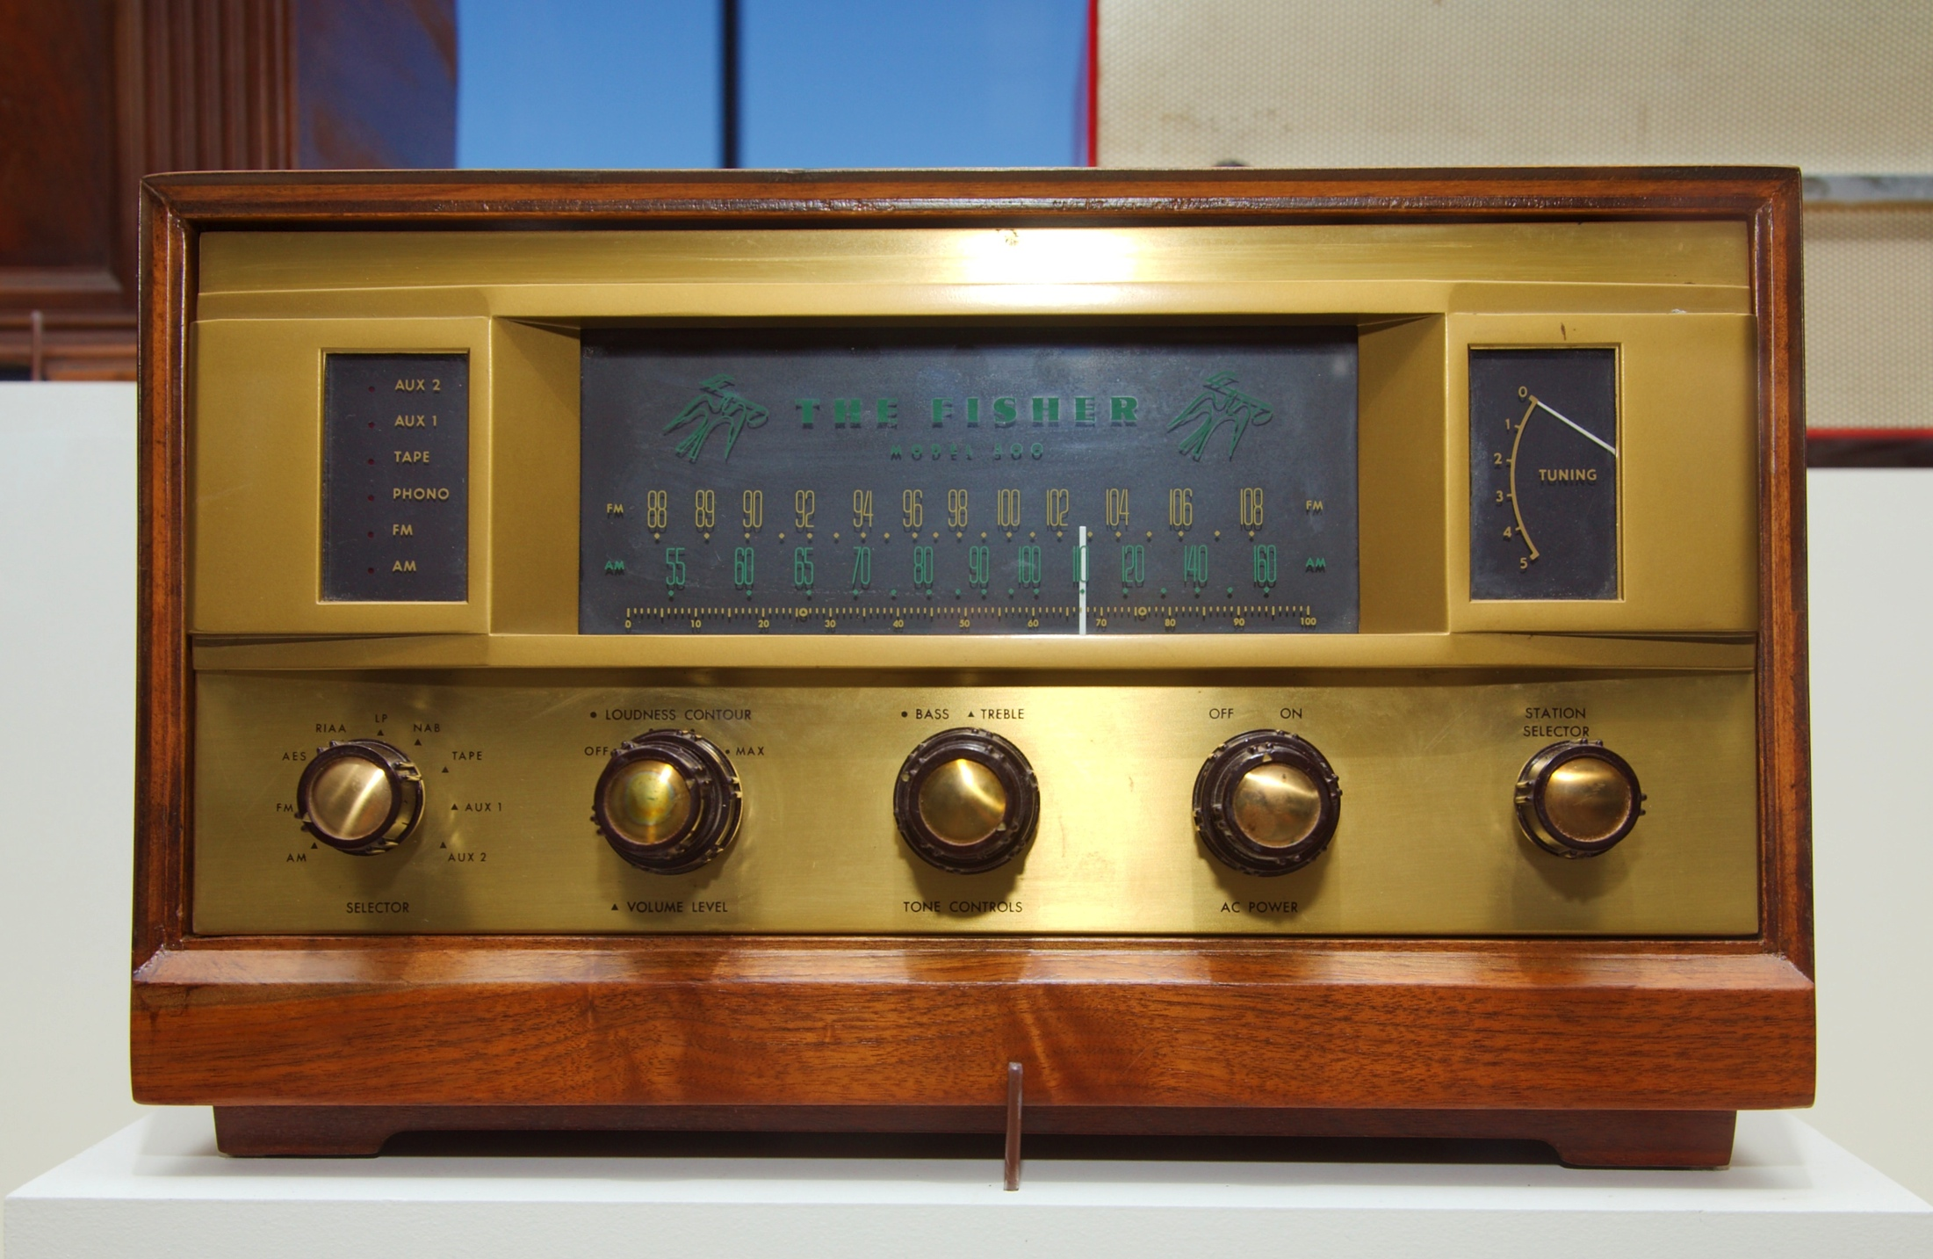
Play-By-Play
Successive Play Sequences
Notes:
https://www.youtube.com/watch?v=RBol-8Gfo5g
golden goal

Slide 41
Our Play-By-Play Data
Source: nhl.com
2007-2015
No Locations
Source: SportLoqig
2015
Action Locations
NHL.com
Teams | 32
Players | 1,951
Games | 9,220
Events | 2,827,467
SportLogiq
Teams | 32
Players | 2,233
Games | 446
Events | 1,048,576

Slide 42
Performance Evaluation: Action-Based Approaches
Basic question: What difference does an action make?
Quantify effect of action on outcome (goal) = action value.
Player contribution = sum of scores of player’s actions.
Schuckers and Curro (2013), McHall and Scarf (2005; soccer).
Example: +/- Score in ice hockey
nhl.com Advanced Stats
Notes:
Action examples. E.g. face-off win -> shot on target.
http://www.nhl.com/stats/player?navid=nav-sts-indiv#
http://thehockeymovement.com/advanced-stats-for-beer-league-hockey/
Problem: different valuable actions, how to combine?

Slide 43
Value Learning for Ice Hockey
Computation
Notes:
value learning = V and Q learning

Slide 44
The Value Function
V(s) = Expected reward starting in state s
Reward | Absorbing States | Q(s) represents
Win | Game End | Win Probability Differential
Goals | Game End | Expected Goal Differential
Goals | Game End + Goals | Next Goal Probability Differential
Penalties | Game End | Expected Penalty Differential
Penalties | Game End + Penalties | Next Penalty Probability Differential
Notes:
Modifying the absorbing state changes what Q(s) represents

Slide 45
Dynamic Programming Algorithm for Value Iteration
Iterative Value function computation (on policy) for i=1,...,h steps.
h is the lookahead horizon
Prob. of Action
Expected Future Reward given action and state
Immediate
reward
Notes:
Factor out occurrences of state to prevent potential issues from numerical instability
No discounting.

Slide 46
Basketball Version
Notes:
Q-value ticker

Slide 47
Evaluating Actions
Examples

Slide 48
The action value function
Expected Future Reward given action and state
Immediate
reward

Slide 49
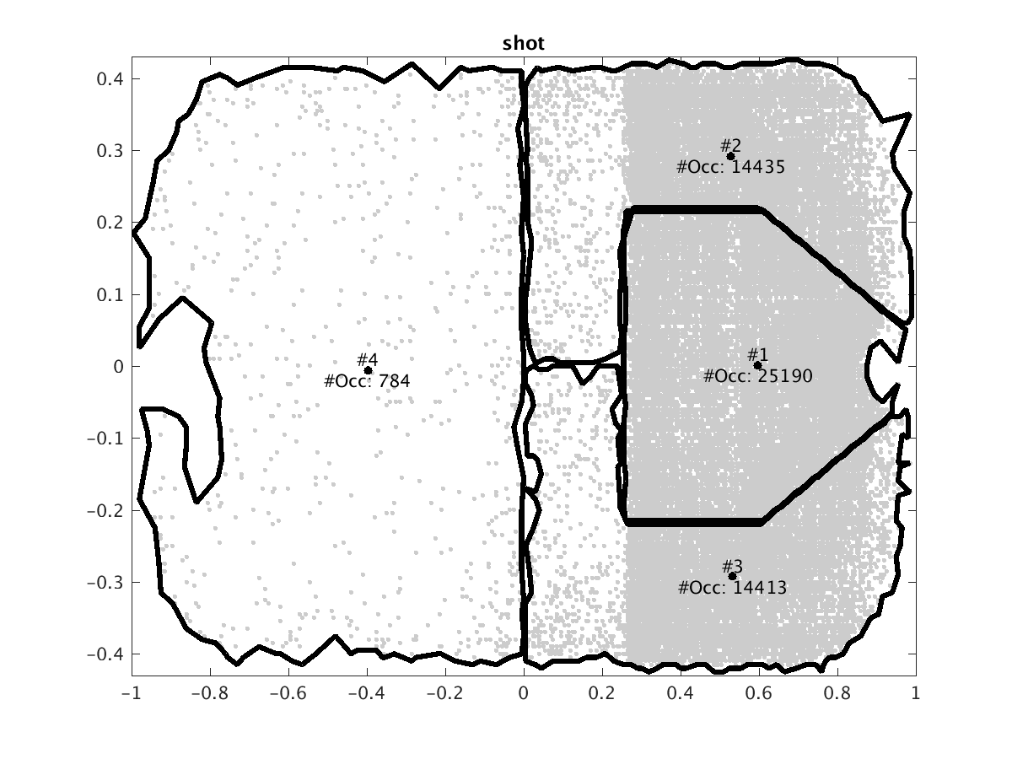
Locations
We discretize locations by clustering the points at which a given action occurs. Example:
Notes:
Action dependent, reduces number of parameters.
Should change scales to that grid points correspond to feet.

Slide 50
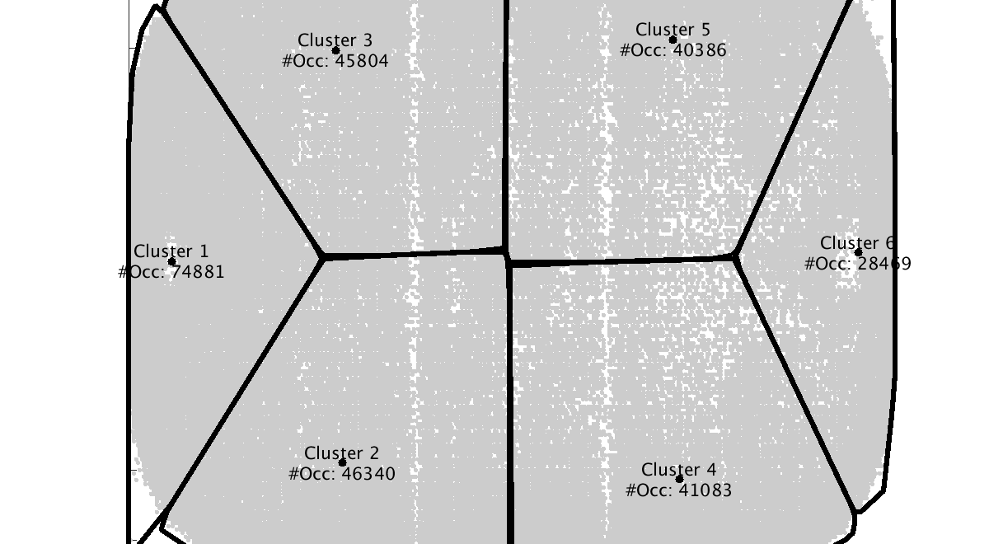
Loose Puck Recovery

Slide 51
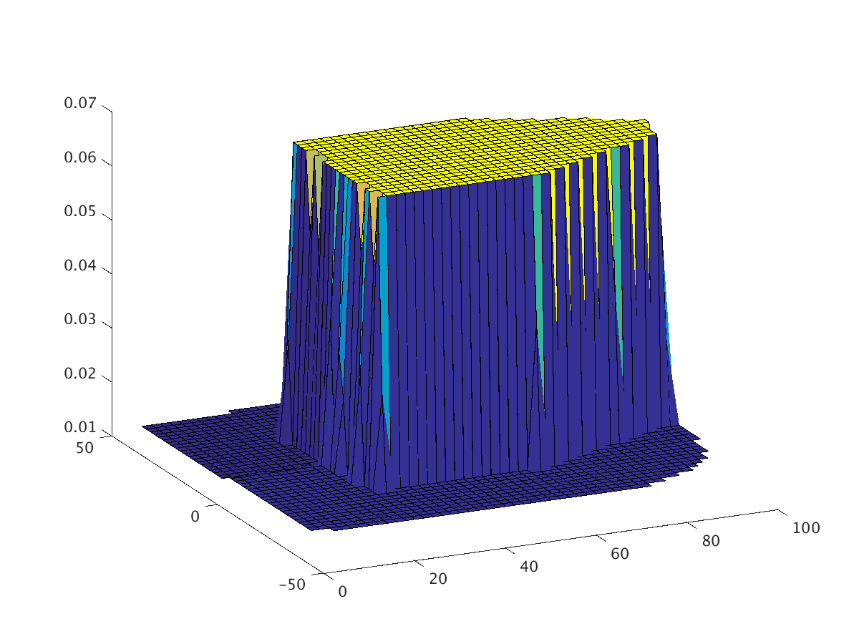
Action value @Location
Average values of actions at location, over all states and both teams.
Action = shot Chance of scoring the next goal lookahead = 1
Notes:
Loses information!
Shot to goal

Slide 52
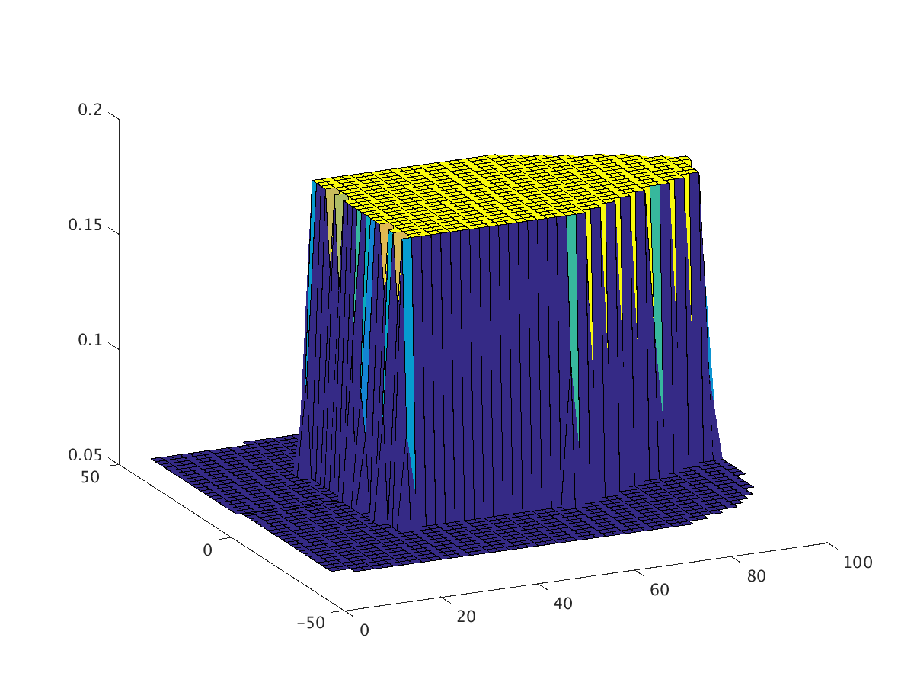
Shot Values, Lookahead
Chance of scoring the next goal lookahead = 1
Chance of scoring the next goal after shot lookahead = 14
Notes:
make scales bigger

Slide 53
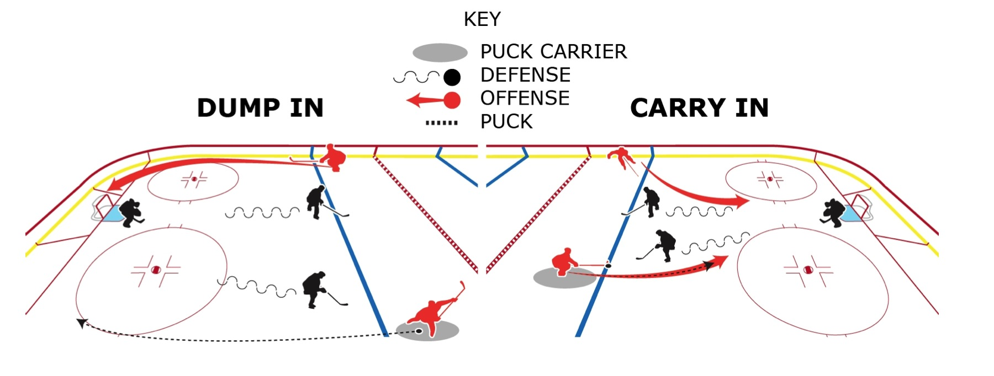
Dump in vs. Carry In
Which is better?
Figure by Shaun Kreider, Kreider Designs.
Notes:
loses context information

Slide 54
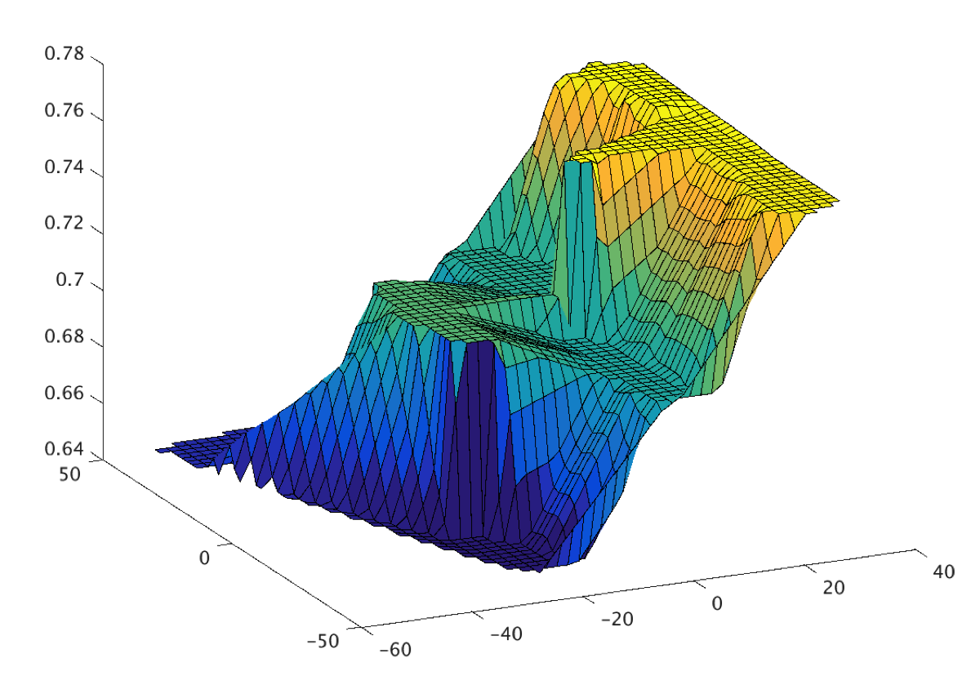
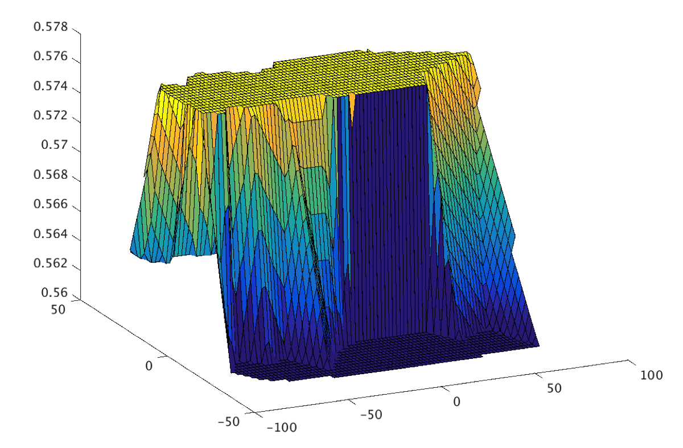
Model Values
Chance of scoring the next goal after dump-in
Chance of scoring the next goal after carry
Notes:
Carry is much better. Even though it’s further from the goal (see clusters).
we lost information.

Slide 55
Evaluating Players and Teams

Slide 56
The Impact of an Action
expected reward after action
expected reward before action

Slide 57
Evaluating Players and Teams
Players
Apply the impact of an action to the player performing the action
Sum the impact of his actions over a game to get his net game impact.
Sum the net game impact of a player over a single season to get his net season impact.
Teams Sum the impact of all players.

Slide 58
Team Performance
Compare
average impact of team in game (our model)
average goal ratio of team in game (independent metric). 2-1 = 4-2 = 6-3
Correlation = 0.7!
Notes:
this is common in blogs
each data point is a team

Slide 59
Team Performance lookahead = 1
Commonly used (e.g. Financial Times)
Correlation only 0.09
Notes:
they use shots only

Slide 60
Player Impact on Goals (2014-15)
2014-15 no location data
Notes:
Sort player values for 2014-2015 regular season and display top-25
No Canucks!
Jason Spezza is interesting case, low Pls minus but high goal impact. Played for senators, senators +- was very bad (-29 goal differential).
Jori Lehtera: High Points, low goals, we captures assists.
Sidney Crosby: high salary for goal impacts.
If you are into ice hockey, it's fun and revealing to look at the resulting rankings. For instance, all three members of St. Louis' famed STL line (Schwartz, Tarasenko, Lehtera) are among the top 20 in our list. In fact, Jori Lehtera tops our goal impact list, although his linemate Tarasenko outscored him by far. Our analysis suggests that Lehtera's actions create the opportunities that Tarasenko exploits, leading to a high goal impact ranking for Lehtera and a high goal score for Tarasenko. This pattern fits the traditional division of labor between a center and a wing player. Tarasenko is also the most undervalued player in our list. Starting with the 2015-2016 season, St. Louis has signed him for an annual average more than 7 times higher, which our analysis strongly supports. Another interesting case is Jason Spezza, who was on top of our goal impact list in the 2013-2014 season. However, his plus-minus score was an awful -26. This is because his team the Ottawa senators was even worse overall (-29 goal differential). The goal impact score rewards players for good decisions even if their teammates do not convert them into goals. After the 2013-2014 season, Spezza requested a trade, which according to our analysis was definitely the right thing for him to do. With the Dallas Stars, his plus-minus score came more in line with his goal impact score, as we would expect (-7 overall, still negative). As I mentioned, we also look at players' impact on penalties. Sadly, two Vancouver Canucks players take spots 2 and 4 when it comes to actions that lead to penalties (Dorsett and Bieksa). Even more sadly, none of the Canucks player make it into the top 20 when it comes to actions that lead to goals.

Slide 61
Player Impact on Goals 2013-2014
Jason Spezza: high goal impact, low +/-.
plays very well on poor team (Ottawa Senators).
Requested transfer for 2014-2015 season.
Notes:
Transferred to Dallas Stars.
Ottawa senators: goal diff of -29.

Slide 62
Consistency Across Seasons
Correlation coefficient = 0.703
Follows Pettigrew(2015)

Slide 63
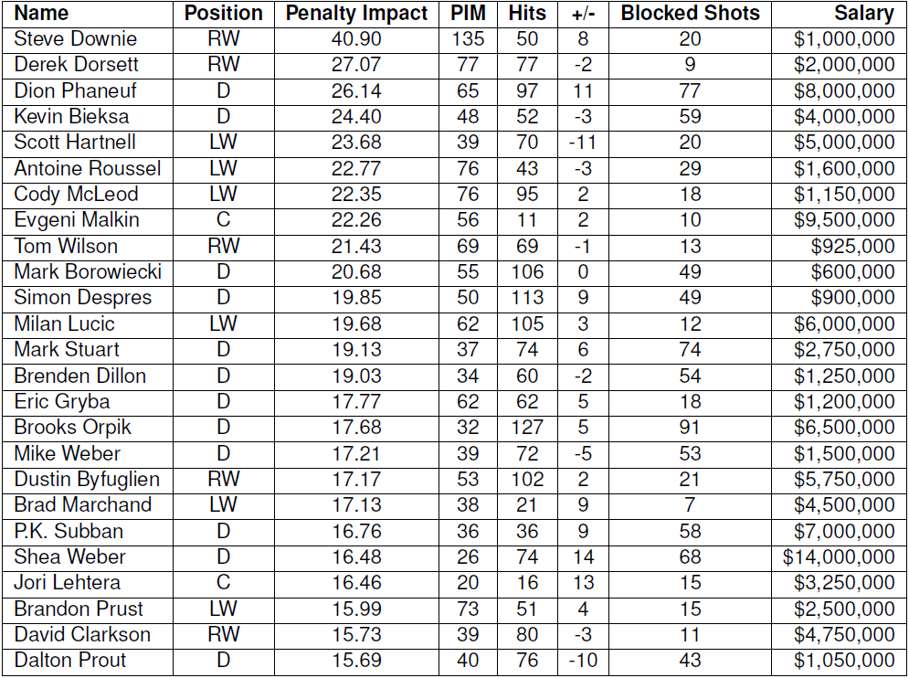
Player Impact on Penalties
2014-15 no location data
Notes:
Can do penalties as well!
Penalties are cost, so high value is bad
2 Canucks in top 4: Derek Dorsett and Kevin Bieksa

Slide 64
Conclusion
Built state-space model of NHL dynamics.
The action-value function in reinforcement learning is just what we need.
Incorporates
context
lookahead
Familiar in AI, revolutionary in sports analytics!

Slide 65
Conclusion
State-space Markov game model for ice hockey dynamics in the NHL.
A new context-aware method for evaluating locations, all actions and players.
“We assert that most questions that coaches, players, and fans have about basketball, particularly those that involve the offense, can be phrased and answered in terms of EPV [i.e. the value function].” Cervone, Bornn et al. 2014.
Notes:
Continuous flow, non-episodic environment.

Slide 66

The End
Thank you – any questions?

Slide 67
References
Cervone, D.; D’Amour, A.; Bornn, L. & Goldsberry, K. (2014), POINTWISE: Predicting points and valuing decisions in real time with NBA optical tracking data, in MIT Sloan Sports Analytics Conference.
Routley, K. & Schulte, O. (2015), A Markov Game Model for Valuing Player Actions in Ice Hockey, in 'Uncertainty in Artificial Intelligence (UAI)', pp. 782--791.

Slide 68
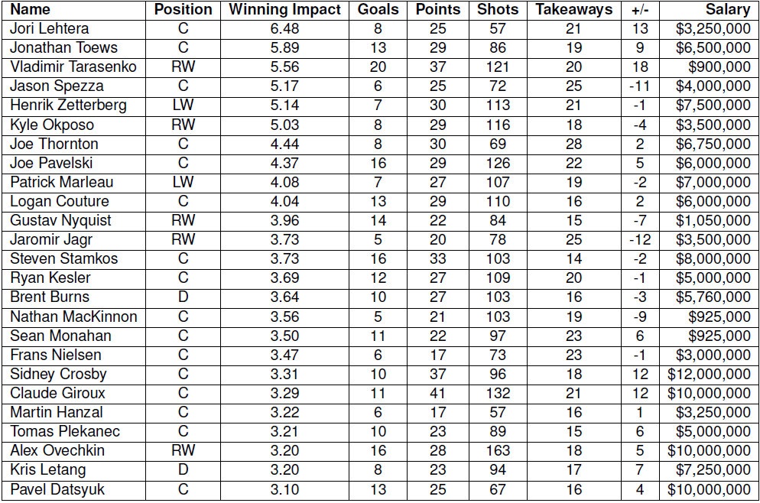
Player Impact on Wins
Notes:
Crosby and Ovechkin’s impact ranking falls from goals to wins, consistent with findings by Pettigrew, where they score many goals but have lower Added Goal Value

Slide 69
Open Questions

Slide 70
Using Player Rankings
No ground truth.
Relate to predicting something (?)
Break down into strong and weak contexts?
Compare Apples-to-Apples.
Cluster players by position.
Learn player clusters.
Interesting ideas in Cervone et al. 2014

Slide 71
Mining the Q-function
Extract patterns about which actions have the most impact when.

Slide 72
Player-Level Modelling
Fit parameters for each player (cricket, baseball, basketball).
Smooth towards similar players when a player visits a state rarely.
Combine reinforcement learning with clustering agents?

Slide 73
Add Continuous Variables
Game Clock.
Penalty Clock.
Player, puck location (eventually).
Can we take existing RL off the shelf?
E.g. continuous finite-time horizon?
Spatial Planning?
RL with both continuous time and space?

